Slide 1
Data structures
Bart Bozon

Slide 2
Content
Arrays
Lists (ArrayList)
Sets
Stack
Heap
Queues
Dicts
Hashmap
Linked lists (single/double)
Trees
Quicksort
Arrays -> Lists -> Sets -> Stack -> Heap -> Queues -> Dicts -> Hashmap -> Linked lists (single/double)-> Trees -> Quicksort

Slide 3
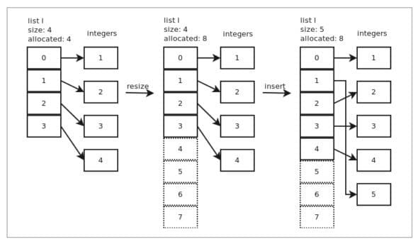
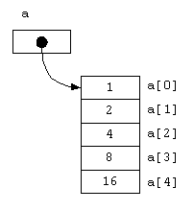
Array vs lists (abstracte typen)
Array is fixed size, low level implemented
List is dynamic size, implementation varies
https://www.opensourceforu.com/2021/05/memory-management-in-lists-and-tuples/
Arrays -> Lists -> Sets -> Stack -> Heap -> Queues -> Dicts -> Hashmap -> Linked lists (single/double)-> Trees -> Quicksort

Slide 4
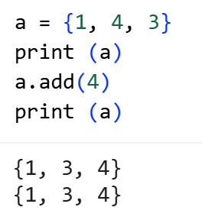
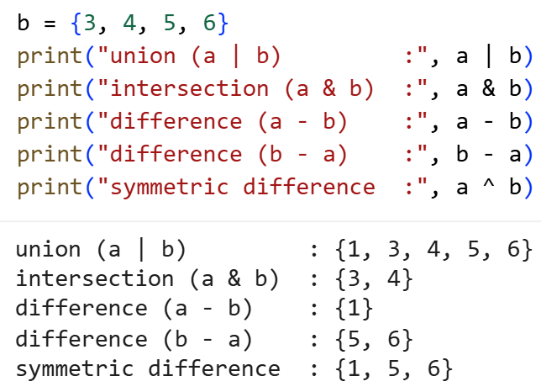
Sets
Arrays -> Lists -> Sets -> Stack -> Heap -> Queues -> Dicts -> Hashmap -> Linked lists (single/double)-> Trees -> Quicksort

Slide 5
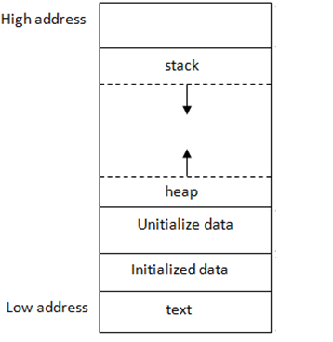
Stack / Heap
Local variables (e.g. calling a function)
Recursion?
Dynamic allocation (e.g. making an object with a constructor)
Arrays -> Lists -> Sets -> Stack -> Heap -> Queues -> Dicts -> Hashmap -> Linked lists (single/double)-> Trees -> Quicksort

Slide 6
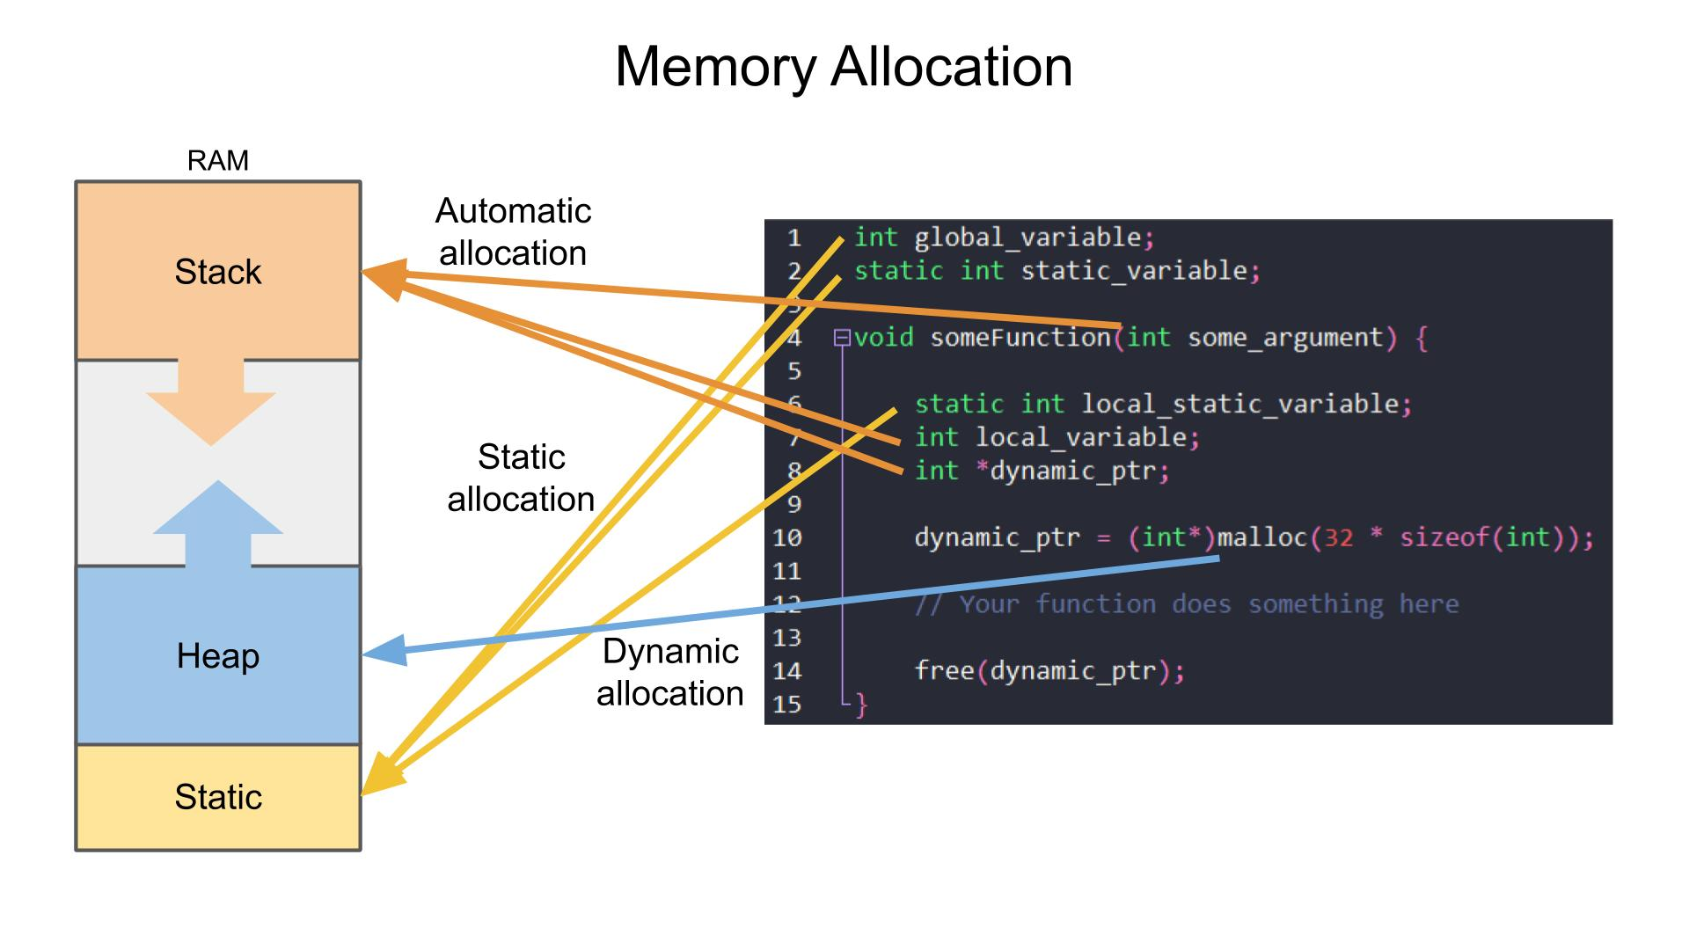
Stack / Heap
Arrays -> Lists -> Sets -> Stack -> Heap -> Queues -> Dicts -> Hashmap -> Linked lists (single/double)-> Trees -> Quicksort

Slide 7
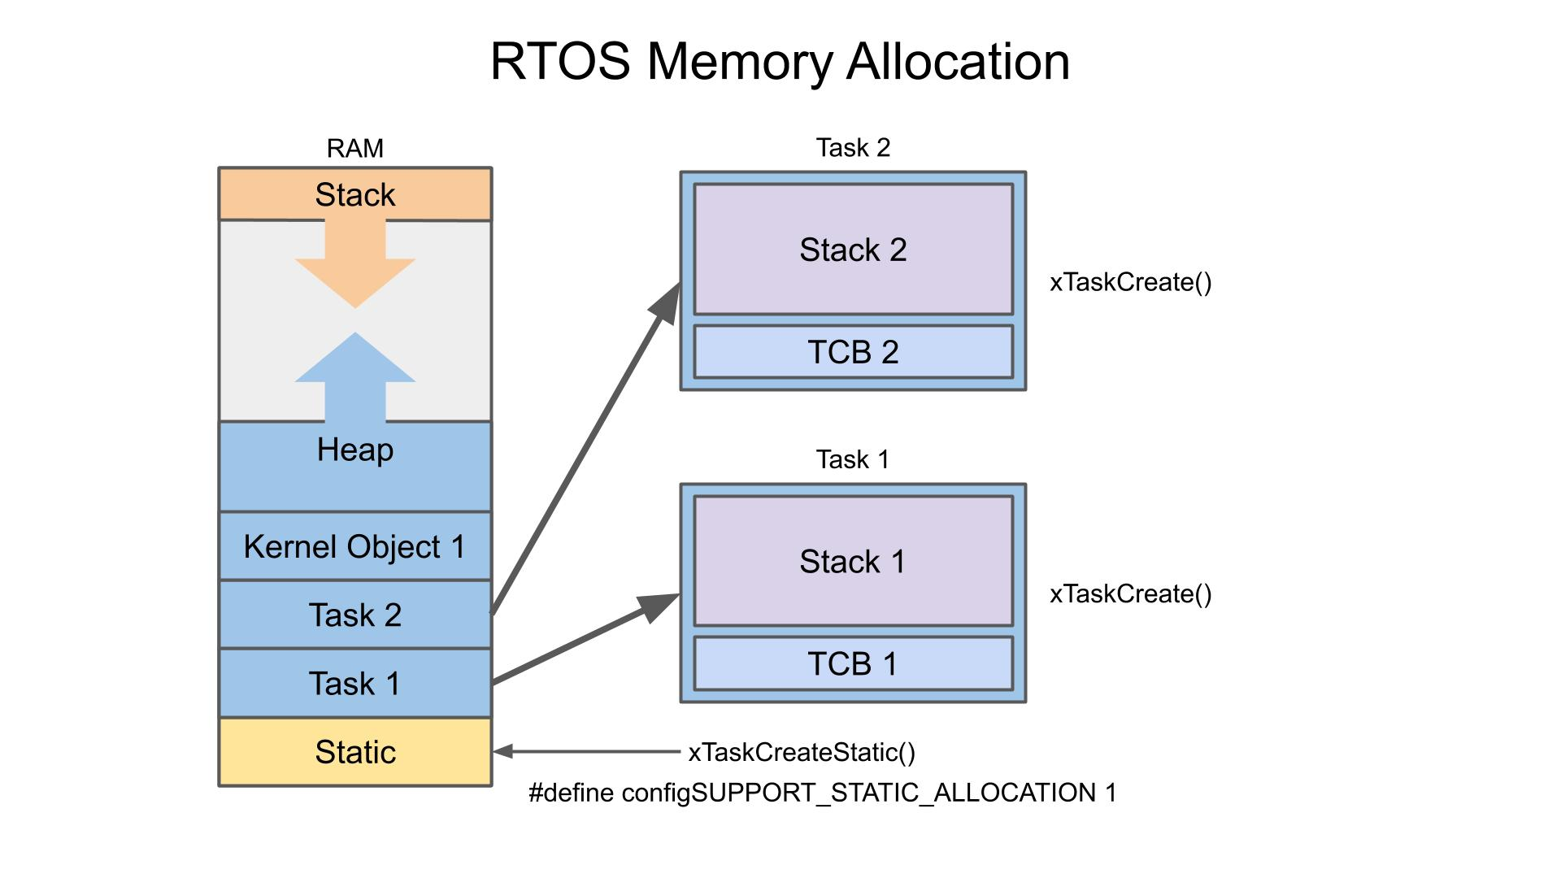
Stack / Heap
https://www.digikey.es/en/maker/projects/introduction-to-rtos-solution-to-part-4-memory-management/6d4dfcaa1ff84f57a2098da8e6401d9c?srsltid=AfmBOope5EsT5idaApq4rnFa_UqB-1vpL4cTnhnAxnGjDERClYkeB0ey
Arrays -> Lists -> Sets -> Stack -> Heap -> Queues -> Dicts -> Hashmap -> Linked lists (single/double)-> Trees -> Quicksort

Slide 8
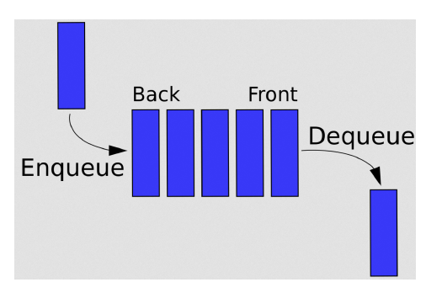
Queues
The insert (queue) method can only change the back of the queue
The remove (dequeue) method can only change the front of the queue
First-in-first-out (FIFO) principle.
Arrays -> Lists -> Sets -> Stack -> Heap -> Queues -> Dicts -> Hashmap -> Linked lists (single/double)-> Trees -> Quicksort

Slide 9
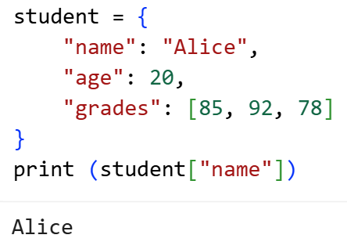
Dict
stores key–value pairs (like a database)
Arrays -> Lists -> Sets -> Stack -> Heap -> Queues -> Dicts -> Hashmap -> Linked lists (single/double)-> Trees -> Quicksort

Slide 10
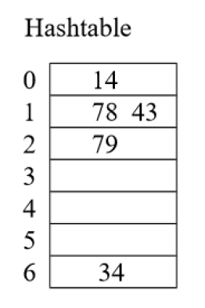
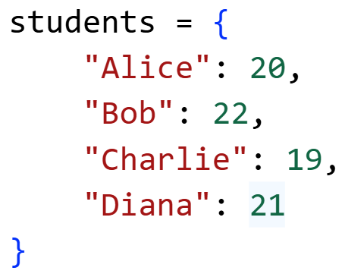
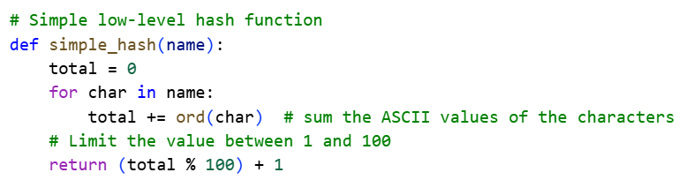
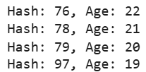
Hashmap
Also stores key value – pairs, but quicker access!
Why quicker access???
What are disadvantages?
Collisions?
Arrays -> Lists -> Sets -> Stack -> Heap -> Queues -> Dicts -> Hashmap -> Linked lists (single/double)-> Trees -> Quicksort

Slide 11
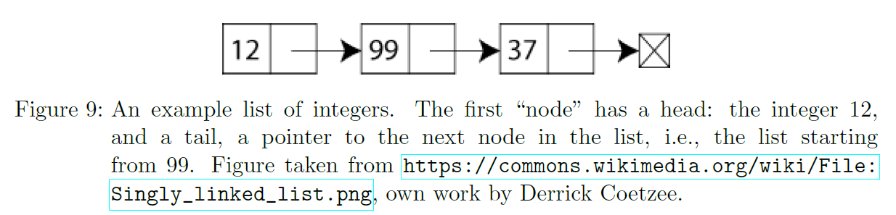
Linked lists
What are disadvantages?
Arrays -> Lists -> Sets -> Stack -> Heap -> Queues -> Dicts -> Hashmap -> Linked lists (single/double)-> Trees -> Quicksort

Slide 12
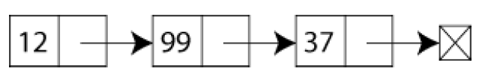
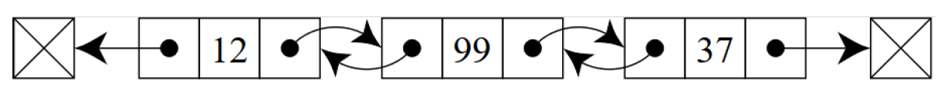
Linked lists
Single
Double
Arrays -> Lists -> Sets -> Stack -> Heap -> Queues -> Dicts -> Hashmap -> Linked lists (single/double)-> Trees -> Quicksort

Slide 13
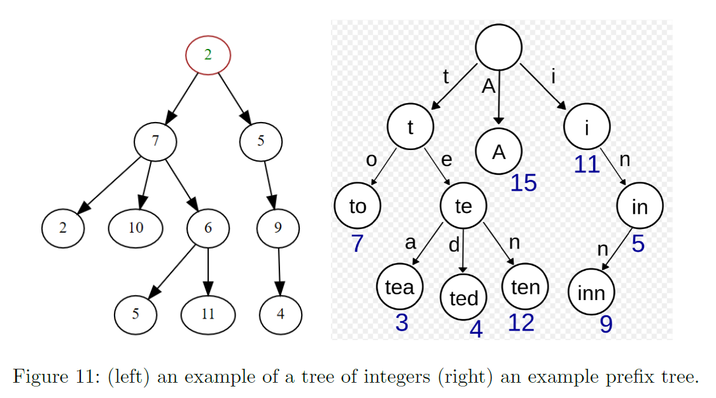
Tree
Arrays -> Lists -> Sets -> Stack -> Heap -> Queues -> Dicts -> Hashmap -> Linked lists (single/double)-> Trees -> Quicksort

Slide 14
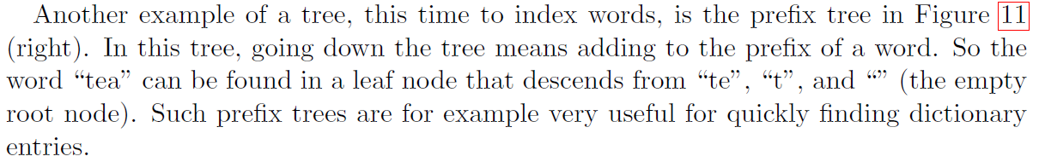
Tree
Arrays -> Lists -> Sets -> Stack -> Heap -> Queues -> Dicts -> Hashmap -> Linked lists (single/double)-> Trees -> Quicksort

Slide 15
Quicksort
Arrays -> Lists -> Sets -> Stack -> Heap -> Queues -> Dicts -> Hashmap -> Linked lists (single/double)-> Trees -> Quicksort

Slide 16
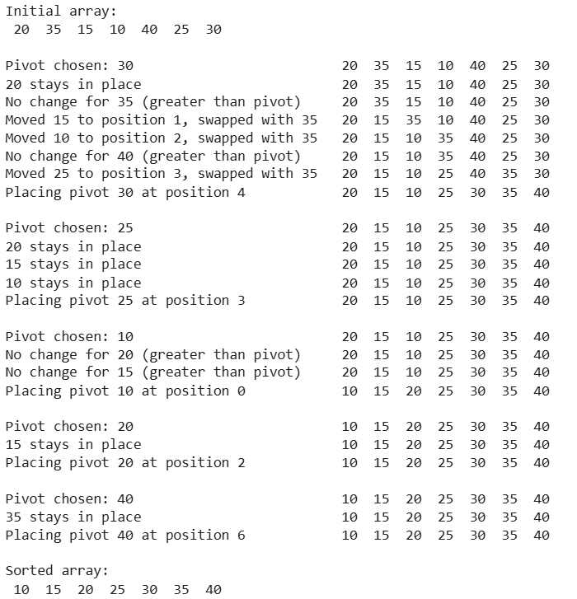
Quicksort
Arrays -> Lists -> Sets -> Stack -> Heap -> Queues -> Dicts -> Hashmap -> Linked lists (single/double)-> Trees -> Quicksort

Slide 17
// Sorts (a portion of) an array, divides it into partitions, then sorts those
algorithm quicksort(A, lo, hi) is
// Ensure indices are in correct order
if lo >= hi || lo < 0 then
return
// Partition array and get the pivot index
p := partition(A, lo, hi)
// Sort the two partitions
quicksort(A, lo, p - 1) // Left side of pivot
quicksort(A, p + 1, hi) // Right side of pivot
// Divides array into two partitions
algorithm partition(A, lo, hi) is
pivot := A[hi] // Choose the last element as the pivot
// Temporary pivot index
i := lo
for j := lo to hi - 1 do
// If the current element is less than or equal to the pivot
if A[j] <= pivot then
// Swap the current element with the element at the temporary pivot index
swap A[i] with A[j]
// Move the temporary pivot index forward
i := i + 1
// Swap the pivot with the last element
swap A[i] with A[hi]
return i // the pivot index

Slide 18




if A[j] <= pivot then
swap A[i] with A[j]
i := i + 1
5, 4 and 6 > 3 so no swap!

Slide 19

if A[j] <= pivot then
swap A[i] with A[j]
i := i + 1
swap A[i] with A[hi]

Slide 20


quicksort(A, lo, p - 1)
if A[j] <= pivot then
swap A[i] with A[j]
i := i + 1

Slide 21



if A[j] <= pivot then
swap A[i] with A[j]
i := i + 1
swap A[i] with A[hi]
if lo >= hi || lo < 0 then
return

Slide 22







quicksort(A, p + 1, hi)
6 > 5 so no swap!
swap A[i] with A[hi]

Slide 24
Content
Arrays
Lists (ArrayList)
Sets
Stack
Heap
Queues
Dicts
Hashmap
Linked lists (single/double)
Trees
Quicksort
Arrays -> Lists -> Sets -> Stack -> Heap -> Queues -> Dicts -> Hashmap -> Linked lists (single/double)-> Trees -> Quicksort

Slide 25
De opdracht
https://github.com/HU-TI-DEV/TI-S4/blob/main/software/algoritmen_en_datastructuren/2_containers_zoeken_sorteren.ipynb

